Slide 1
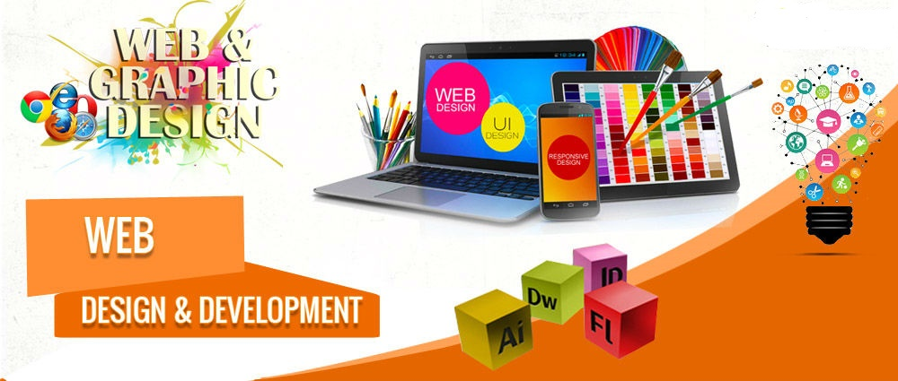
Graphic & Web Development
-By Aryan Pariyar

Slide 2

Adobe InDesign
-By Aryan Pariyar

Slide 3
Familiarize InDesign
-By Aryan Pariyar

Slide 4
What is Adobe InDesign?
The main purpose of Adobe InDesign is Layout Design
Master of Handling the Huge Text Design
Create and publish books, digital magazines, eBooks, posters, and interactive PDFs with InDesign
-By Aryan Pariyar

Slide 5
What is Adobe InDesign?
InDesign is a professional desktop publishing software developed by Adobe Systems. It is widely used in the publishing industry for creating various types of documents, such as brochures, flyers, magazines, and books. InDesign allows users to create layouts with text, graphics, and images, and has powerful tools for typography and layout design.
-By Aryan Pariyar

Slide 6
Open a new document:
File > New > Document.(Ctrl + N)
This will open a dialog box where you can specify the document settings, such as the page size,
number of pages, and margins.
-By Aryan Pariyar

Slide 7
Save a document:
File > Save or File > Save As || (Ctrl + S)
And choose a location to save the file. InDesign files have the extension .indd.
-By Aryan Pariyar

Slide 8
Print in InDesign
File > Print, || ( Ctrl + P)
and choose your printer and print settings. You can also preview the document before printing to
ensure that everything looks as you intended.
-By Aryan Pariyar

Slide 9
Place Text/Graphics:
-By Aryan Pariyar

Slide 10
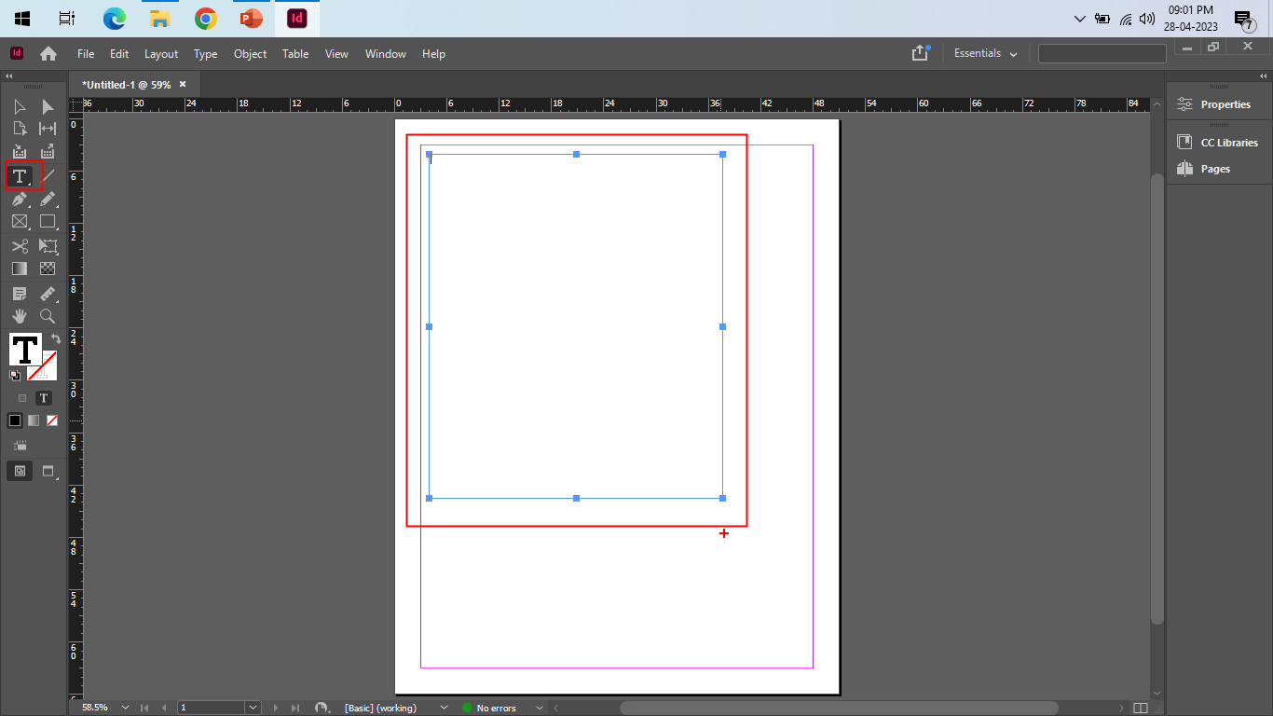
To place text and graphics in InDesign, you can follow these steps:
Select the Type Tool from the toolbar on the left-hand side of the screen.
बायाँतर्फको स्क्रिनमा Toolbar बाट टाइप टुल Select गर्नुहोस्।
Click and drag to create a text frame where you want the text to go.
Text लाई राख्न चाहानुभएको स्थानमा Text frame बनाउन लागि Click र Drag गर्नुहोस्
-By Aryan Pariyar

Slide 11
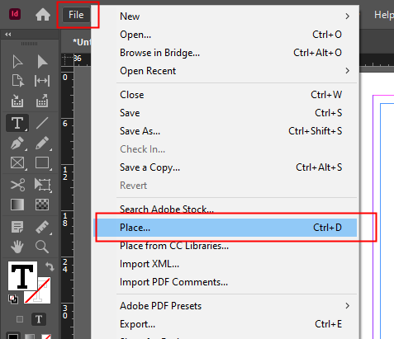
To place text and graphics in InDesign, you can follow these steps:
With the text frame selected, go to File > Place, and select the text file you want to add to the document. The text will automatically flow into the text frame.
Text Frame छानिएको अवस्थामा,
File > Place मा जानुहोस्, र Documents मा थप्न चाहनुभएको Text File छान्नुहोस्।
Text स्वचालित रूपमा Text Frame मा Flow हुनेछ।
-By Aryan Pariyar

Slide 12
To place text and graphics in InDesign, you can follow these steps:
To add graphics, go to File > Place, and select the image file you want to add. Click and drag to create an image frame where you want the graphic to go. You can then resize and position the image as needed.
Graphics Add गर्नका लागि,
File > Place मा जानुहोस्, र तपाईंले जुन Image file add गर्न चाहनुहुन्छ त्यसलाई छान्नुहोस्।
Image को स्थान बनाउन Click र Drag गर्नुहोस् जहाँ तपाईं Graphic राख्न चाहनुहुन्छ। त्यसपछि आवश्यक छ भने Image को Size र Position निर्धारित गर्न सक्नुहुनेछ।
-By Aryan Pariyar

Slide 13
To place text and graphics in InDesign, you can follow these steps:
To adjust the text and graphic placement, you can use the selection tool to move, resize, or rotate the text or graphic frames.
Text र Graphics प्लेसमेन्ट Adjust गर्न,
तपाईंले Text वा Graphic Frameहरू Move, Resize गर्न वा Rotate गर्न Selection Tool प्रयोग गर्न सक्नुहुन्छ।
-By Aryan Pariyar

Slide 14
Types of Graphic Images:
-By Aryan Pariyar

Slide 15
InDesign supports various types of graphic images, including:
Vector graphics:
Vector graphics are created using mathematical equations and are
resolution-independent, meaning (यसको मतलब ) that they can be scaled up or down without losing quality.
Examples of vector graphics include logos, icons, and illustrations.
Vector graphics अरु mathematical equation use गरेर बनाइएको हुन्छन्
र यिनीहरु resolution-independent हुन्छन् | यसको मतलब हामीले quality loose नगरी Vector graphics लाई scale Up वा scale down गर्नसक्छौं
-By Aryan Pariyar

Slide 16

Raster images:
Raster images are made up of pixels and are resolution-dependent, meaning that their quality decreases when they are scaled up.
Examples of raster images include photographs and scanned images.
Raster Imageहरू Pixles (BATA) मिलेर बनेका हुन्छन् र रिजोल्युसनमा निर्भर हुन्छन्, यसको मतलब तिनीहरूको गुणस्तर घट्दै जान्छ When they scaled up.
-By Aryan Pariyar

Slide 17
EPS (Encapsulated PostScript) files:
EPS files are vector graphics files that can be imported into InDesign. They are often used for logos and other graphic elements that need to be high-quality and scalable.
EPS फाइलहरू भेक्टर ग्राफिक्स फाइलहरू हुन् जसलाई InDesign मा Import गर्न सकिन्छ । तिनीहरू प्राय: लोगो र अन्य ग्राफिकको लागि प्रयोग गरिन्छ र जुन High Quality र Scalable हुन आवश्यक छ।
-By Aryan Pariyar

Slide 18
PDF (Portable Document Format) files:
PDF files can contain both vector and raster graphics
and are often used for importing complex graphics into InDesign.
PDF filesमा हामीले दुवै vector and raster graphics contain गर्नसक्छ or राख्न सक्छौं र हामीले InDesing मा complex graphics हरु import गर्न पनि pdf use गर्छौं
-By Aryan Pariyar

Slide 19
InDesign Native Graphics :
InDesign also allows you to create graphics within the program
using tools such as the Pen Tool and the Shape Tool.
InDesign ले हामीलाई Program भित्र ग्राफिक्स Create गर्न अनुमति दिन्छ, Pen Tool र Shape Tool जस्ता Toolहरू Use गरेर।
-By Aryan Pariyar

Slide 20
Thank You
-By Aryan Pariyar

